Slide 1
- Intramolecular FORCES

Slide 2
Unit Learning Goal
Throughout this unit we will be working on ALL of our learning goals.
Our learning goal with respect to understanding concepts is:
We are learning to describe the periodic trends in the periodic table, and how elements combine to form chemical bonds.

Slide 3
To support this goal today’s learning goal is…
We are learning about the different physical properties of ionic and covalent compounds (understanding concepts).
We are learning to explain the difference between the formation of ionic bonds and covalent bonds (understanding concepts).
We are learning to draw Lewis structure to represent the bonds in ionic and molecular compounds (communication).

Slide 4
INTRAMOLECULAR BONDING
Forces within a molecule
Hold the molecule together
Occurs to fulfill the OCTET RULE
  Atoms bond to completely FILL or EMPTY their Valence shell
  Achieve electron configuration similar to Noble Gases

Slide 5
Types of bonding
Intramolecular – within the molecule
Ionic
Covalent
  Polar Covalent
  Non-Polar Covalent
Metallic

Slide 6
Properties of
Ionic vs. Covalent Structures
Ionic structures | Molecular (covalent) Structures
High Melting & Boiling Points | Lower melting and boiling points the intermolecular forces of attraction are comparatively weak. You don't have to break any covalent bonds in order to melt or boil a molecular substance.
Usually solid at normal room conditions | Tend to be gases, liquids or low melting point solids at room temperature

Slide 7

Ionic structures | Molecular (covalent) Structures
Cleave in a straight line
Hard and Brittle | Softer and waxy
Non- conductors in solid form Form electrolytes and conduct in liquid form | Do not conduct electricity in solid or liquid form

Slide 8
Ionic structures | Molecular (covalent) Structures
Soluble in water Water molecules are polar; that is, they have a positive end and a negative end. The positive and negative ends of the water molecules tend to pull the ions out of their solid crystal structure Insoluble in nonpolar or organic solvents | Most are insoluble (or only very sparingly soluble) in water. Those which do dissolve often react with the water, or else are capable of forming hydrogen bonds with the water.

Slide 9
Ionic Bond
The electrostatic attractive force between the oppositely charged ions produced when a metal atom transfers one or more electrons to a non-metal atom
Formation of a crystal lattice (billions of positive and negative ions packed together – forming a repeating pattern/lattice)
This is different from a water molecule which always contains 2 hydrogen and 1 oxygen atom exactly at any given time.
Example: Sodium chloride

Slide 10

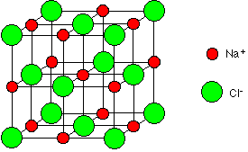
Sodium chloride – Ionic compound
Sodium chloride makes a
6:6 coordinated crystal lattice

Slide 11
Why is NaCl 6:6 co-ordinated?
Maximum number of chlorine ions that can fit around a central sodium ion is 6 (this works vice versa as well).
This works because there is a 1:1 ratio of sodium ions and chlorine ions (due to their charges).
For a crystal lattice of magnesium chloride, the crystal lattice will not be 6:6....

Slide 12
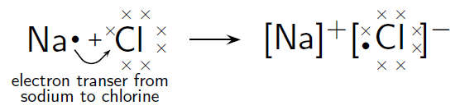
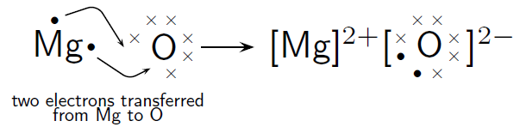
IONIC BONDS

Slide 13


IONIC BOND Diagrams
Draw the Lewis structures of Mg and Cl to show the IONIC BONDING
Compound: MgCl₂
Mg ²⁺ Cl ¹⁻
Mg
MgCl₂
EXPLAINS WHERE THE “CRISS CROSS RULE” COMES FROM

Slide 14
Let's try…
Mg/O
Na/N
Mg/N
Ga/O
And now these:
  Lithium/Sulfur
  Beryllium/Oxygen
  Calcuim/Phosphorus
  Sodium/Nitrogen
  Aluminum/Oxygen
  Potassium/Fluorine
  Beryllium/Chlorine

Slide 15
Success Criteria
By the end of this lesson…
I can explain the difference between the formation of ionic and covalent bonds (understanding concepts).
I can draw Lewis structures to represent the bonds in ionic and molecular compounds (communication).

